Slide 1

Department of Computer Science and Engineering
Spotify Music Trend Analysis
Batch Members: 2320030015 - Vikyath 2320030058 – Amulya 2320030354 - Dinesh | Domain Data Engineering Under the Guidance of Dr. N. Shirisha, Assoc.Prof.

Slide 2

Abstract
The project analyzes Spotify music streaming data to understand listening habits and emerging trends.
It uses track metadata, audio features, and listener engagement metrics, applying ETL pipelines for data handling.
Large-scale data is processed using batch and incremental techniques for efficient storage and querying.
The analysis uncovers trends in genres, artist popularity, temporal and regional listening patterns, and correlations with song attributes.
Insights are presented through visualizations and dashboards to support data-driven decisions and personalized listener experiences.

Slide 3
Introduction
The Spotify Music Trend Analysis project focuses on exploring and interpreting large-scale music streaming data to understand user behavior and preferences.
It leverages publicly available Spotify datasets, including track metadata, audio features, and listener engagement metrics.
The project applies core data engineering principles, including data collection, cleaning, transformation, and storage, to manage and process the data effectively.
By analyzing trends in genres, artists, listening patterns, and regional preferences, the project provides insights that can guide music production, marketing strategies, and personalized recommendations.

Slide 4
Literature Survey
IFPI Engaging with Music 2023
Studies analyze streaming data to understand user preferences and music trends.
Audio features like danceability, energy, and tempo strongly influence listener engagement.
Research shows music preferences vary by time, region, and culture.
ETL pipelines and cloud processing are key for handling large-scale music data efficiently.

Slide 5
Objectives
To analyze Spotify music streaming data to identify trends in genres, artists, and listener preferences.
To study the relationship between audio features (like danceability, energy, tempo, and valence) and listener engagement.
To implement ETL pipelines for efficient data collection, cleaning, transformation, and storage.
To visualize insights through charts and dashboards that support data-driven decisions in music production and marketing.

Slide 6
Problem Statement
With the rapid growth of digital music streaming, vast amounts of data are generated daily on platforms like Spotify, making it difficult to manually identify listening patterns and emerging trends.
There is a lack of comprehensive analysis connecting audio features and listener engagement to understand what makes certain songs or genres more popular.
Without proper analysis, music producers, marketers, and streaming platforms miss opportunities to make data-driven decisions for personalized recommendations and audience targeting.

Slide 7
Existing System
Existing systems mainly rely on basic analytics from streaming platforms like Spotify Wrapped.
They provide limited insights focused only on user activity, not deep trend analysis.
Current tools lack integration with advanced data engineering workflows like ETL pipelines.

Slide 8
Proposed System
The proposed system automates data collection, cleaning, transformation, and visualization using ETL pipelines for large-scale Spotify data.
It provides advanced analytical insights on genre trends, artist popularity, and listener behavior through interactive visualizations and dashboards.

Slide 9
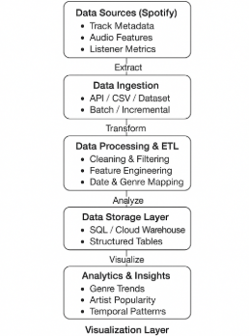
Block Diagram of Proposed System

Slide 10
List of Modules
Importing necessary packages
Loading the dataset
Displaying column names for guidance
Selecting column for analysis
Choosing number of top categories
Counting top categories and displaying table
Plotting pie chart for top categories
Detecting date/year column (if any)
Processing date/year column for year-wise analysis
Selecting year and filtering dataset
Counting top categories for selected year
Plotting pie chart for selected year
Optional: Saving cleaned or transformed data

Slide 11
Details about the tools to be used for the project implementation
This project uses Python 3.8+ with Pandas for data handling, Matplotlib for visualizations, and NumPy for numerical computations.
The dataset is provided in CSV format.

Slide 12
Module Explanation
Importing necessary packages: All the essential Python libraries such as Pandas, Matplotlib, and NumPy are imported to run the program successfully. Loading the dataset: The CSV dataset containing Spotify music charts is retrieved and loaded into a DataFrame. Exploring the dataset: Column names and sample data are displayed to understand the structure of the dataset. Selecting column for analysis: The user chooses which column (e.g., genre, artist) to analyze from the dataset. Counting top categories: The most frequent categories in the selected column are counted and displayed in a tabular format. Visualizing data: Pie charts are plotted to show the distribution of top categories for better understanding. Year-wise analysis: If a date or year column exists, the dataset is filtered year-wise, and top categories for the selected year are displayed and visualized. Optional data storage: The cleaned or transformed dataset can be saved for future analysis or reporting purposes.

Slide 13
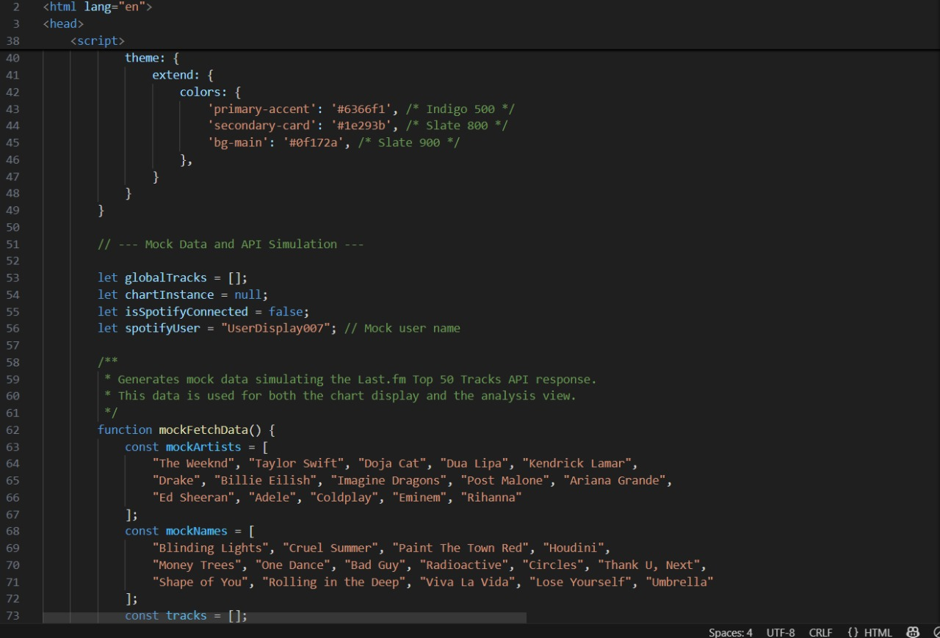
Module Implementation and Result

Slide 14
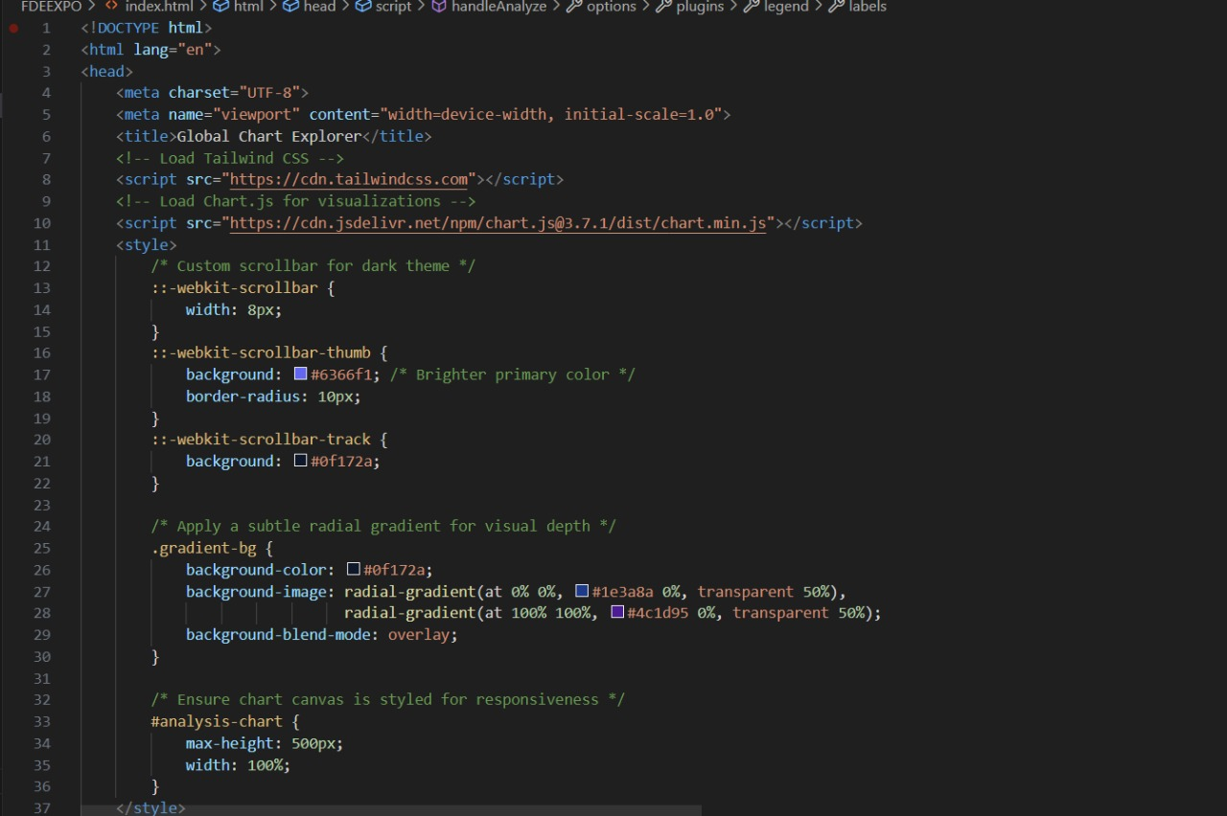

Slide 15
Results
The program starts by displaying all column names from the dataset for user selection. After the user chooses a column and specifies the number of top categories, it generates a frequency table showing the most common values. A pie chart visualizes the distribution of these top categories. If a date or year column is present in the dataset, the program enables year-wise filtering, allowing users to view category distributions for specific years through both tables and pie charts. This provides an interactive way to explore categorical data patterns across different time periods.

Slide 16
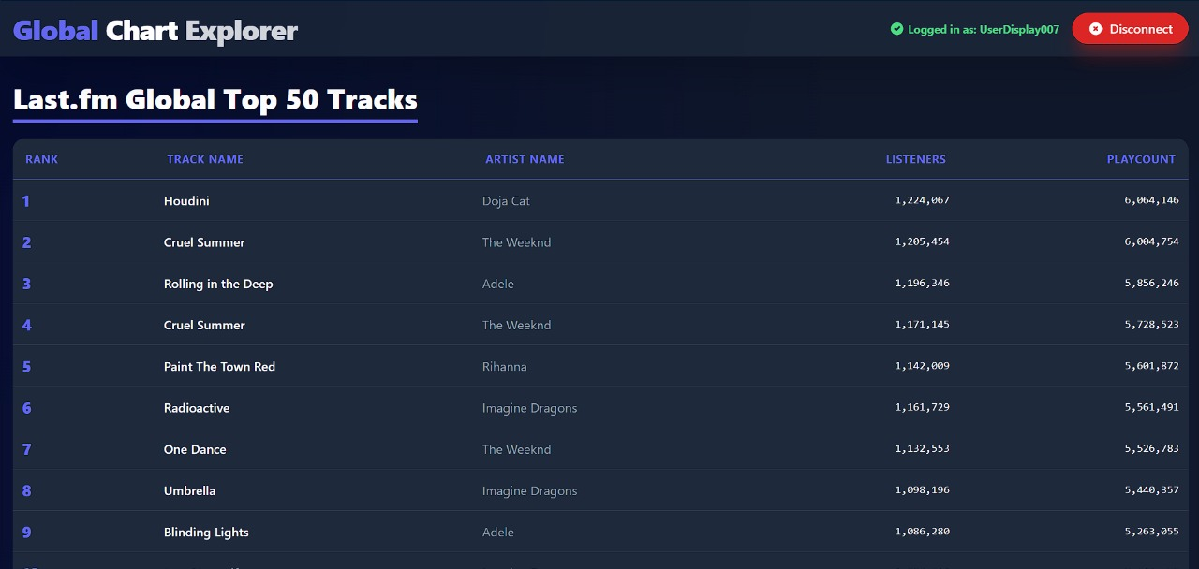

Slide 17
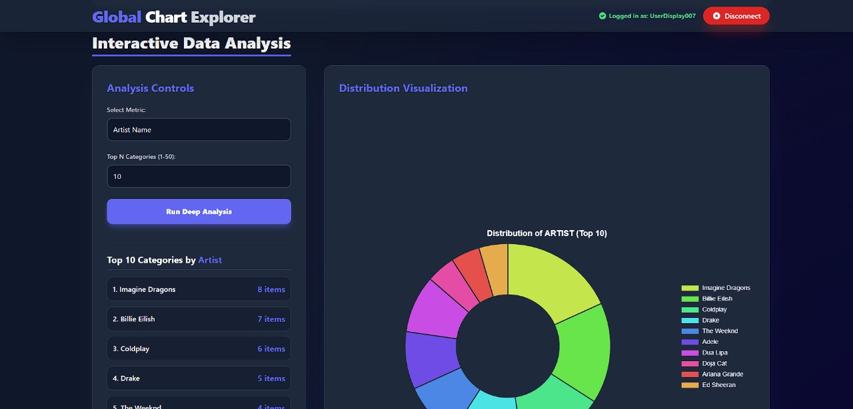

Slide 18
References
McKinney, W. (2017). Python for Data Analysis: Data Wrangling with Pandas, NumPy, and IPython. 2nd Edition. O’Reilly Media.
VanderPlas, J. (2016). Python Data Science Handbook: Essential Tools for Working with Data. O’Reilly Media.
Hunter, J. D. (2007). Matplotlib: A 2D Graphics Environment. Computing in Science & Engineering, 9(3), 90–95.
Spotify Charts. (2025). Spotify Top 200 & Viral 50 Datasets. https://spotifycharts.com/regional
Géron, A. (2019). Hands-On Machine Learning with Scikit-Learn, Keras, and TensorFlow. 2nd Edition. O’Reilly Media.
Python Software Foundation. (2025). Python Documentation. https://www.python.org/doc/

Slide 19
Thank You
Notes:
nhghggffghh

